Slide 1
Simulation of Ideal Gas
Pranav Abbaraju

Slide 2
Assumptions Using KMT
Small particles in constant random linear motion
No interactive forces
Average kinetic energy depends on temperature
Maxwell-Boltzmann distribution for total velocities (but each vector component follows normal curve)
Additional Assumptions
Ignore particle-particle collisions
Argon gas
What I Want to Verify
Ideal Gas Law: PV=nRT
Compressibility Factor: Z=PV/nRT (equals 1 for ideal)
Boyle’s Law: P1V1=P2V2
Gay-Lussac’s Law: P1/T1=P2/T2

Slide 3
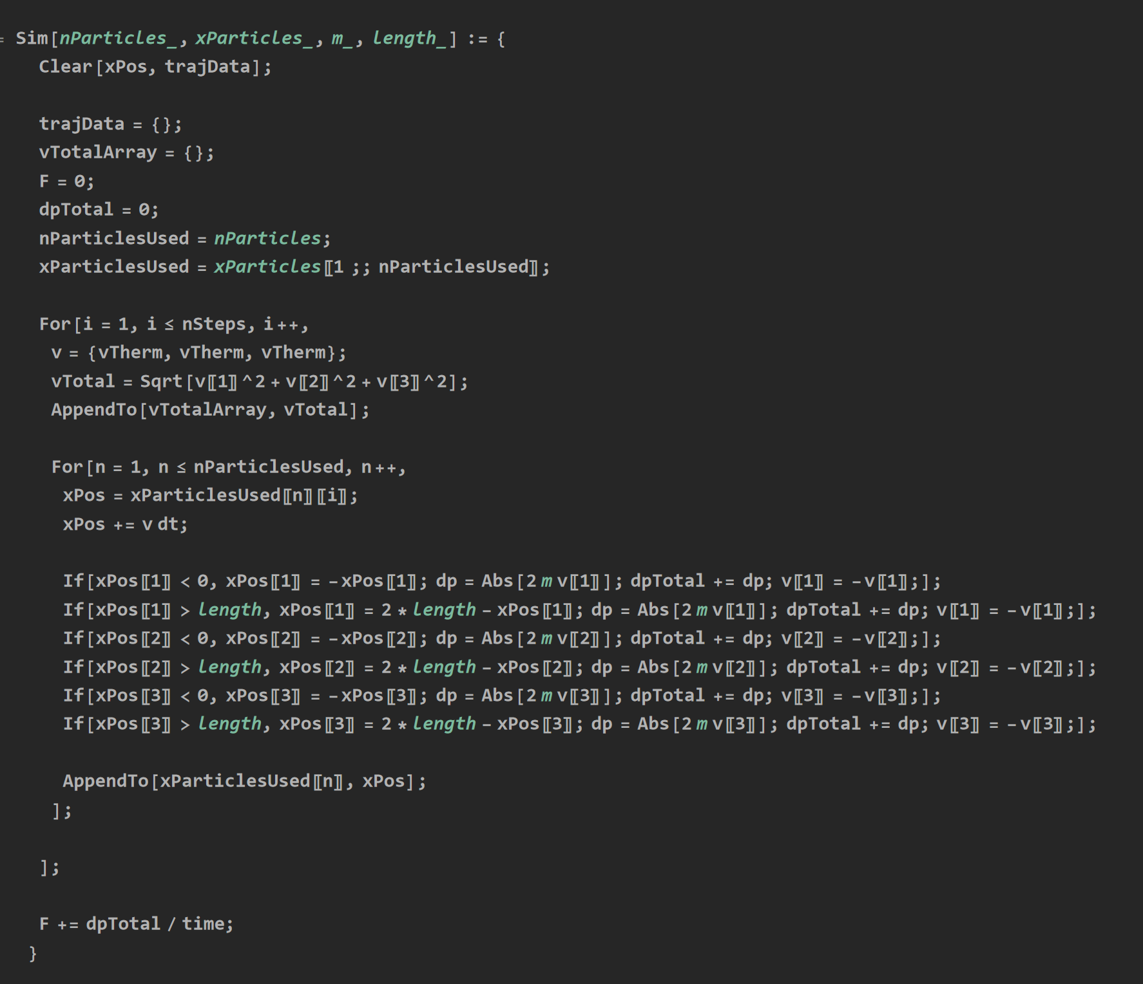
Simulation of Particles in a Box

Slide 4
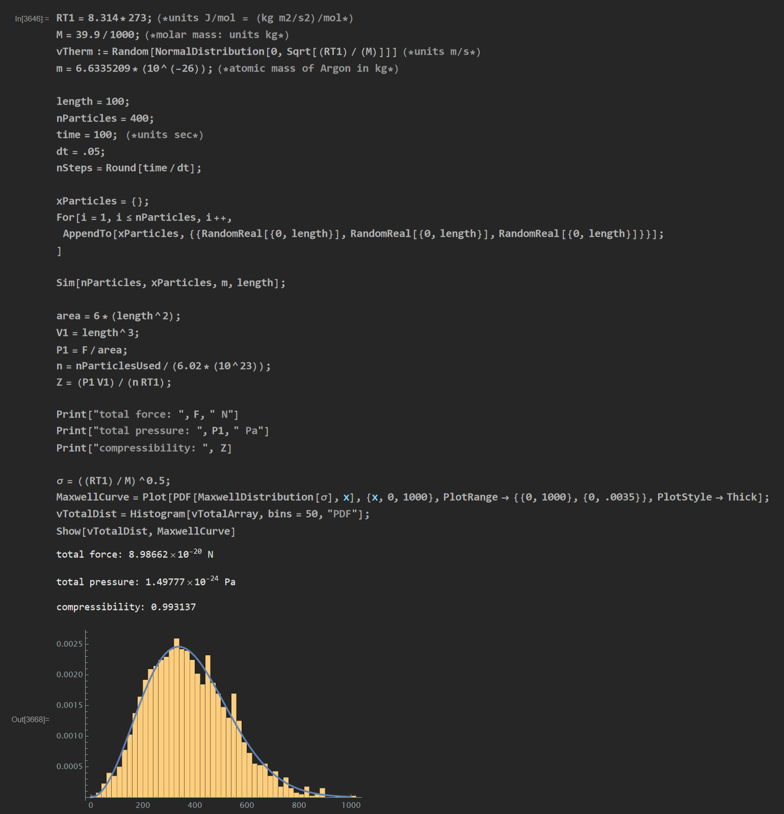
Conditions: Argon molar mass, atomic mass T=273K Time=100sec dt=.05sec Box Length=100m # of Particles=400 Result: Z=0.99137 Very close to 1!
Verifying Ideal Gas Law

Slide 5
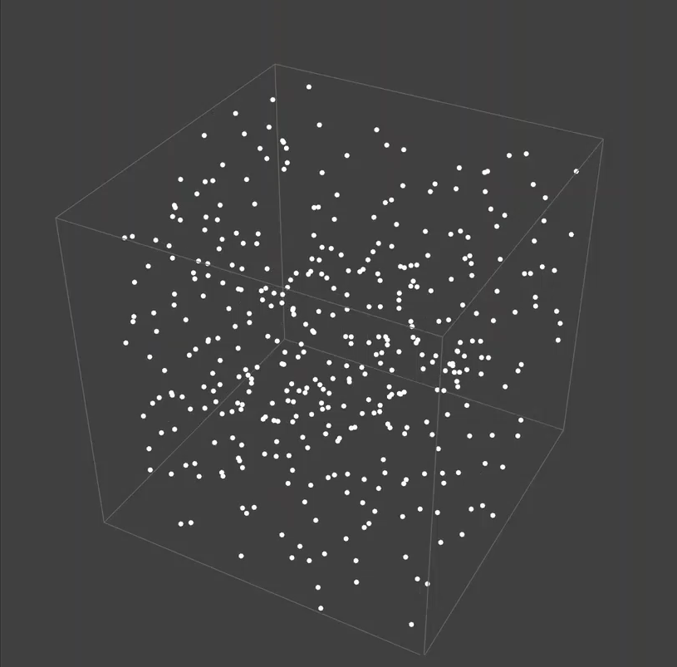
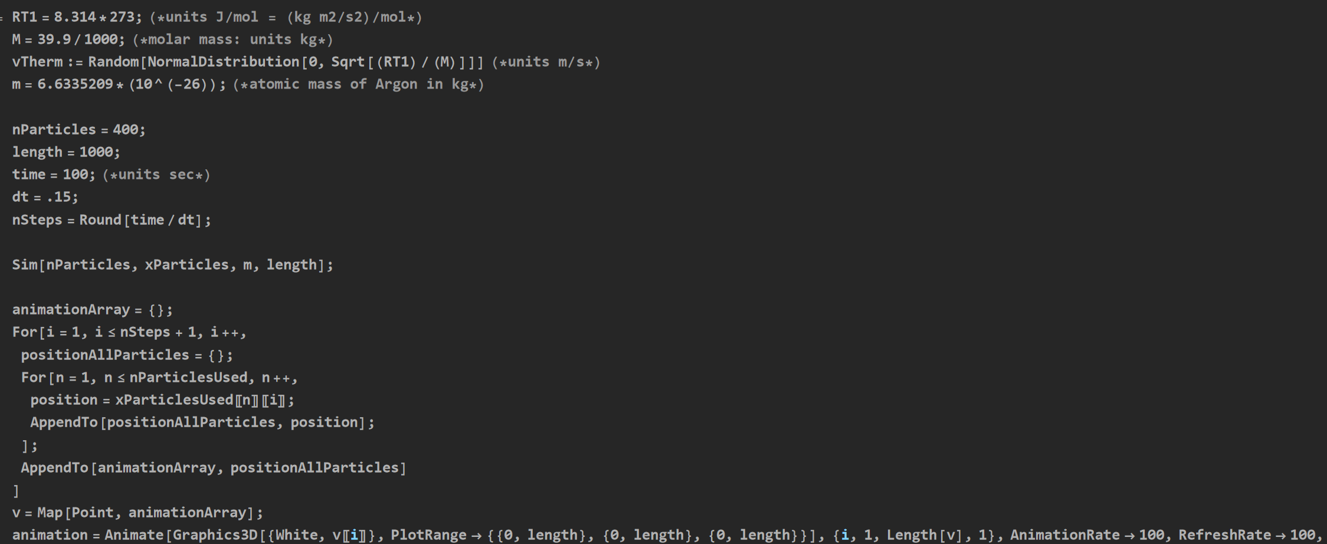
Conditions: T=273K Box Length=1000m # of Particles=400

Slide 6
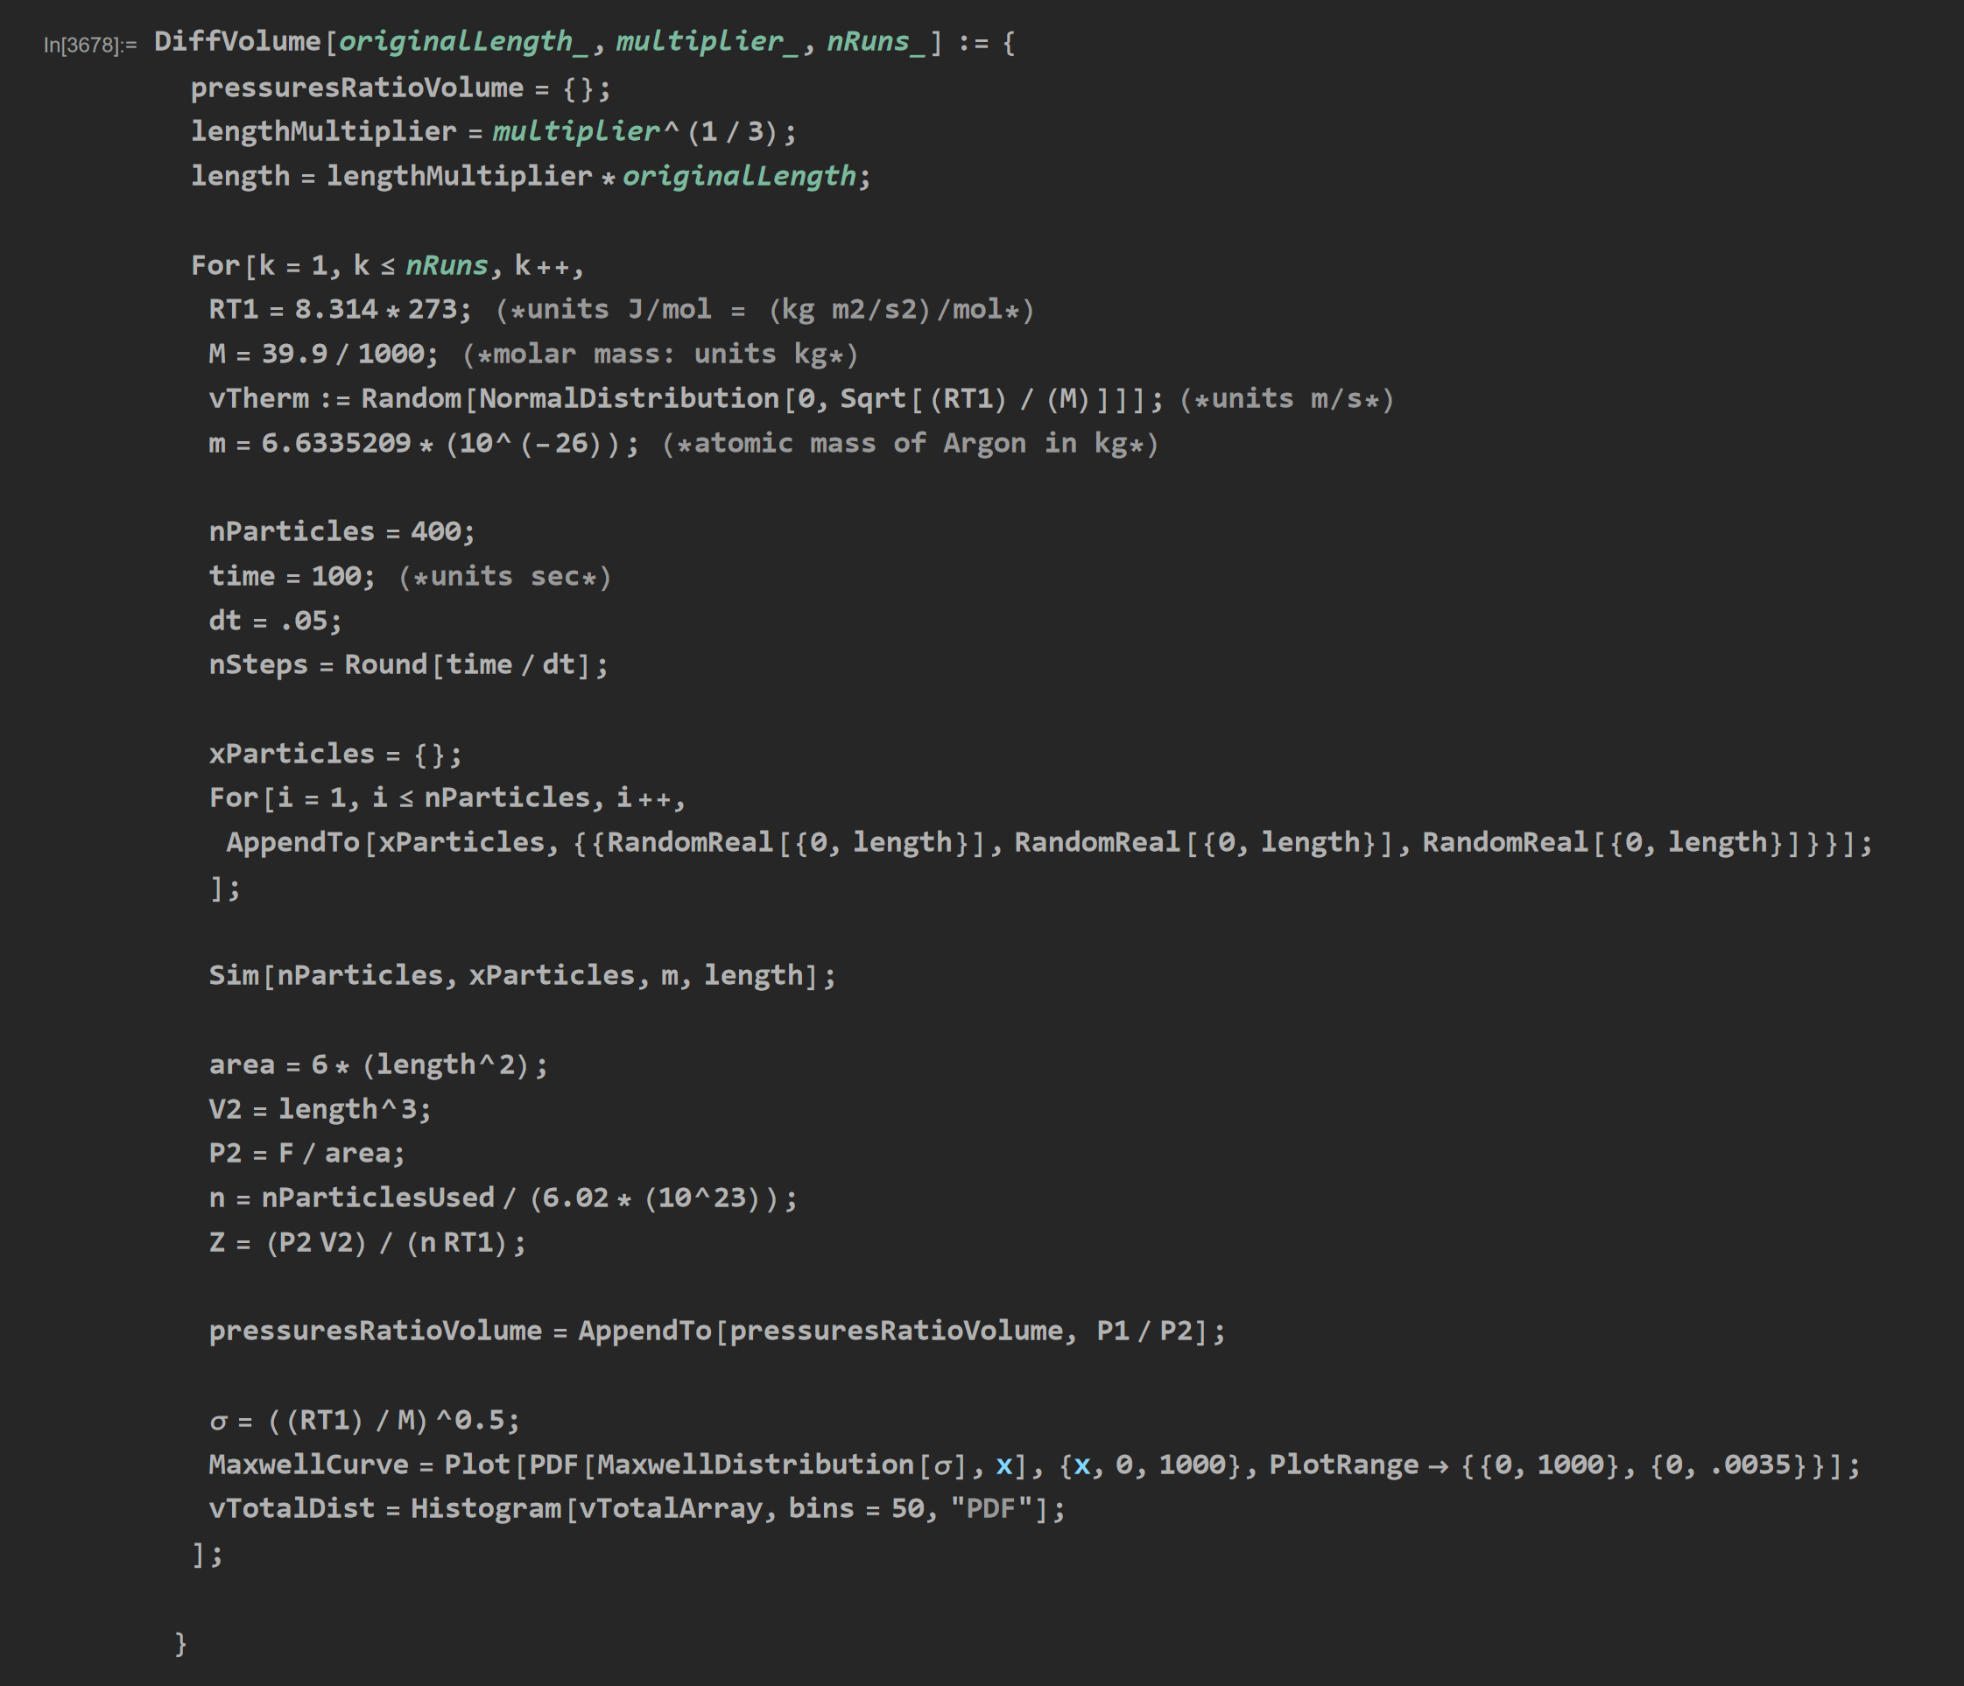
Verifying Boyle’s Law: Simulation at Different Volume

Slide 7
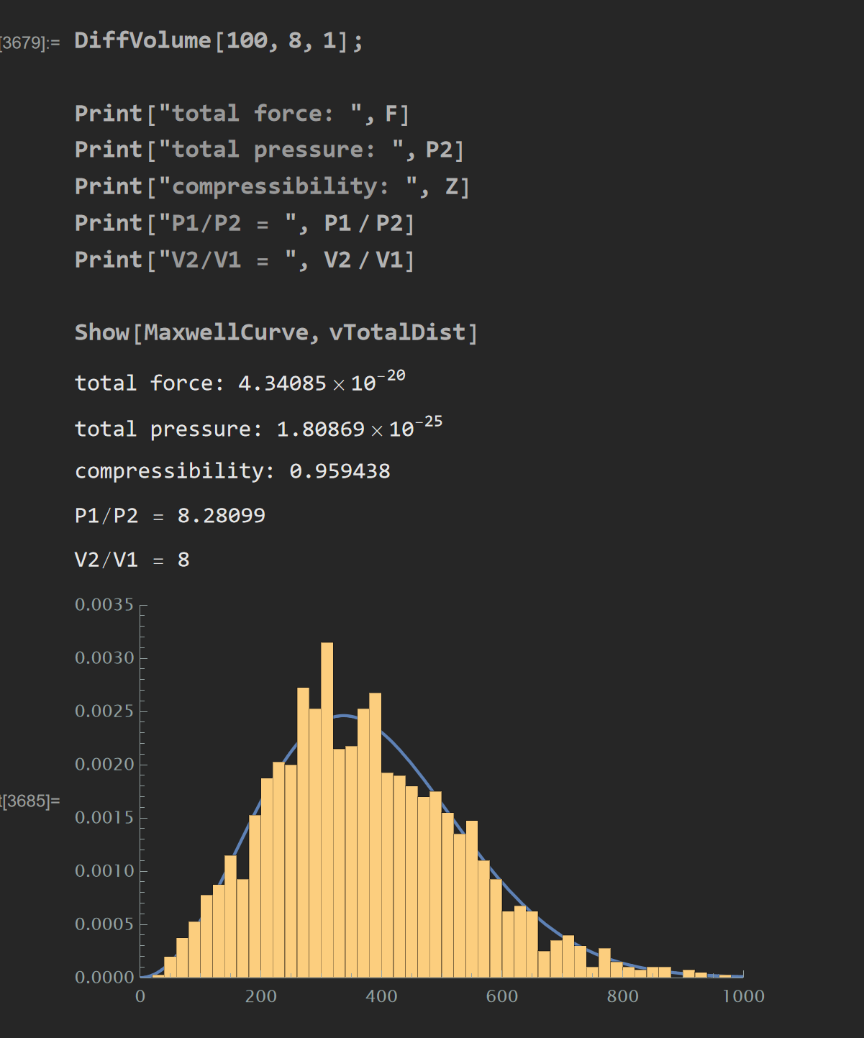
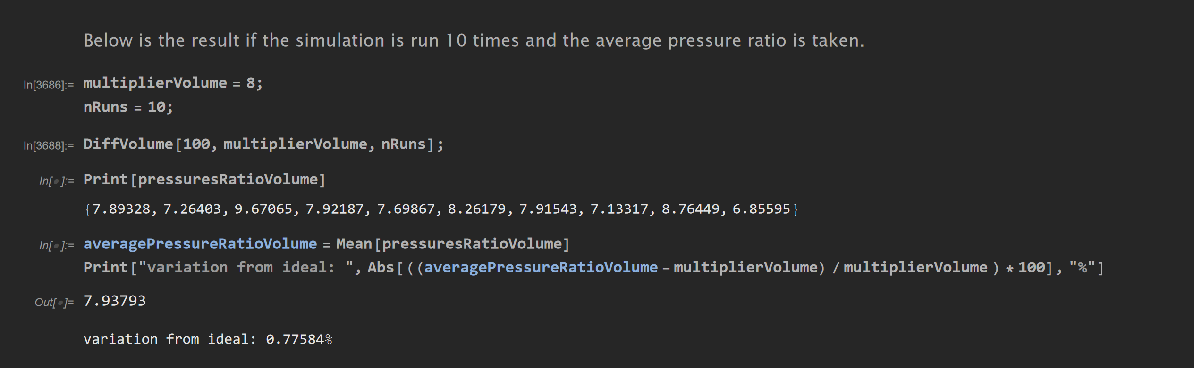
Condition: V2/V1=8 Result with 1 Run: P1/P2=8.28099 Result with 10 Runs: Avg P1/P2=7.93793 Variation from Ideal = 0.77584%

Slide 8
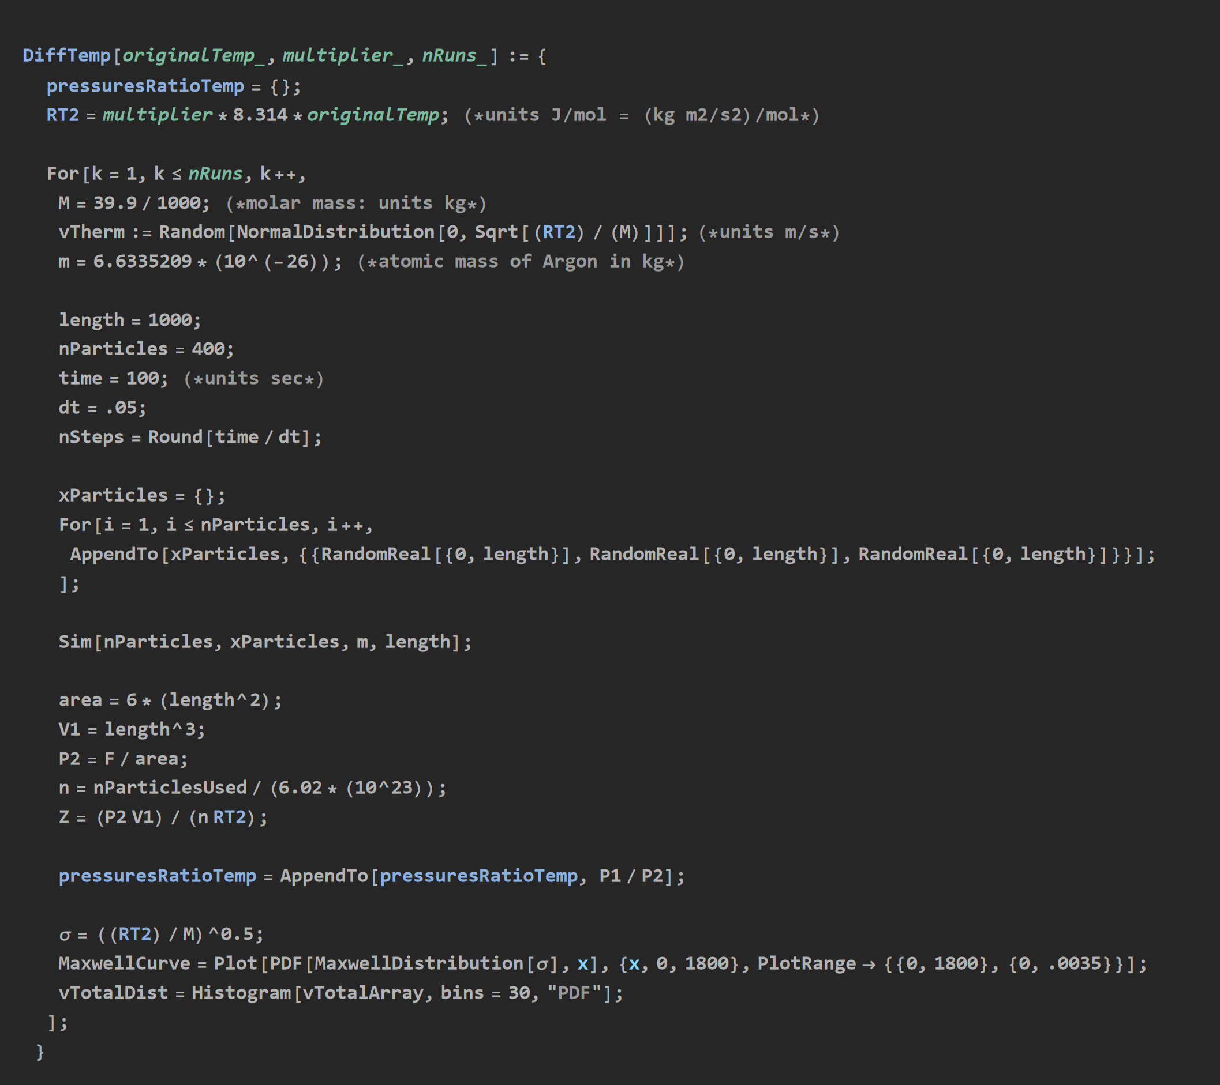
Verifying Gay-Lussac’s Law: Simulation at Different Temperature

Slide 9
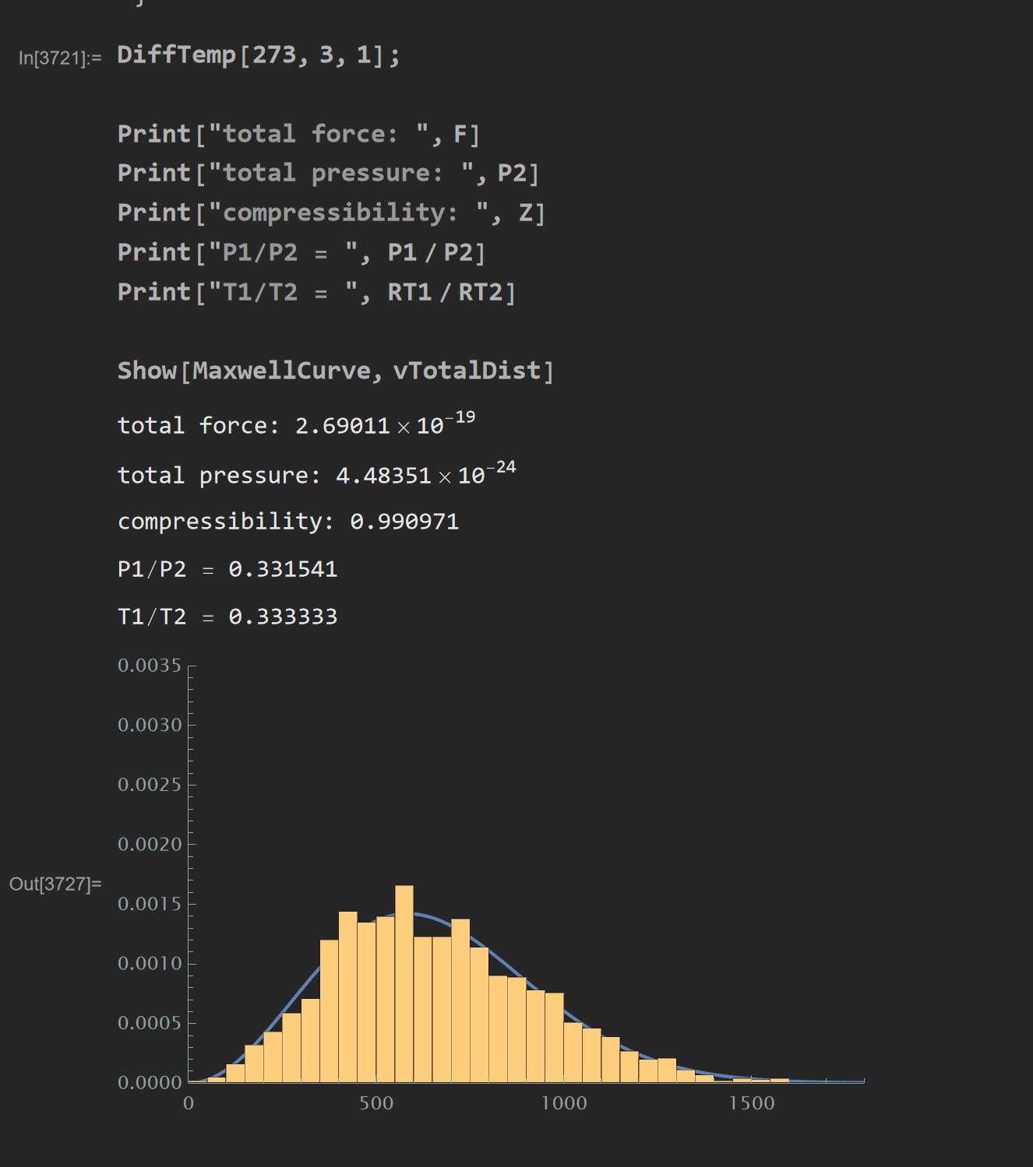
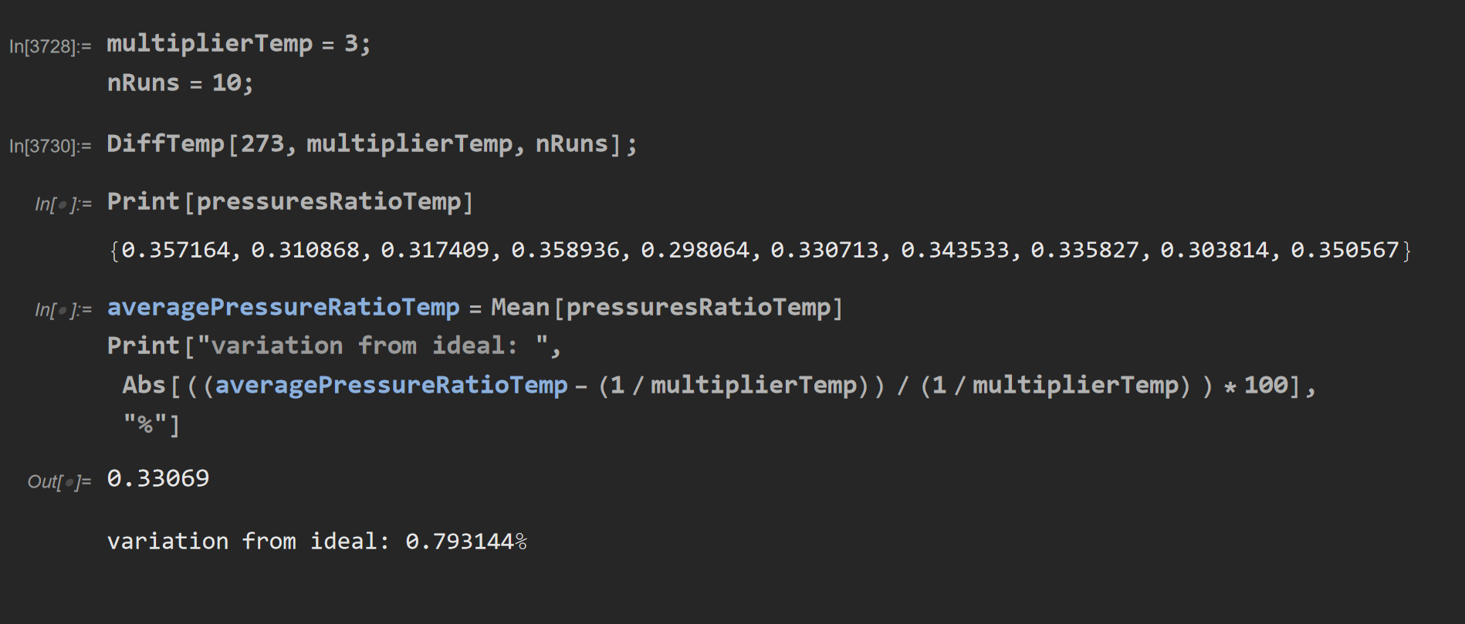
Condition: T1/T2=1/3 Result with 1 Run: P1/P2=0.331541 Result with 10 Runs: Avg P1/P2=0.33069 Variation from Ideal = 0.7933144%

Slide 10
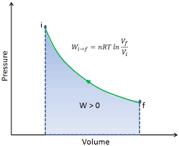
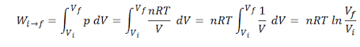
Isothermal Compression

Slide 11
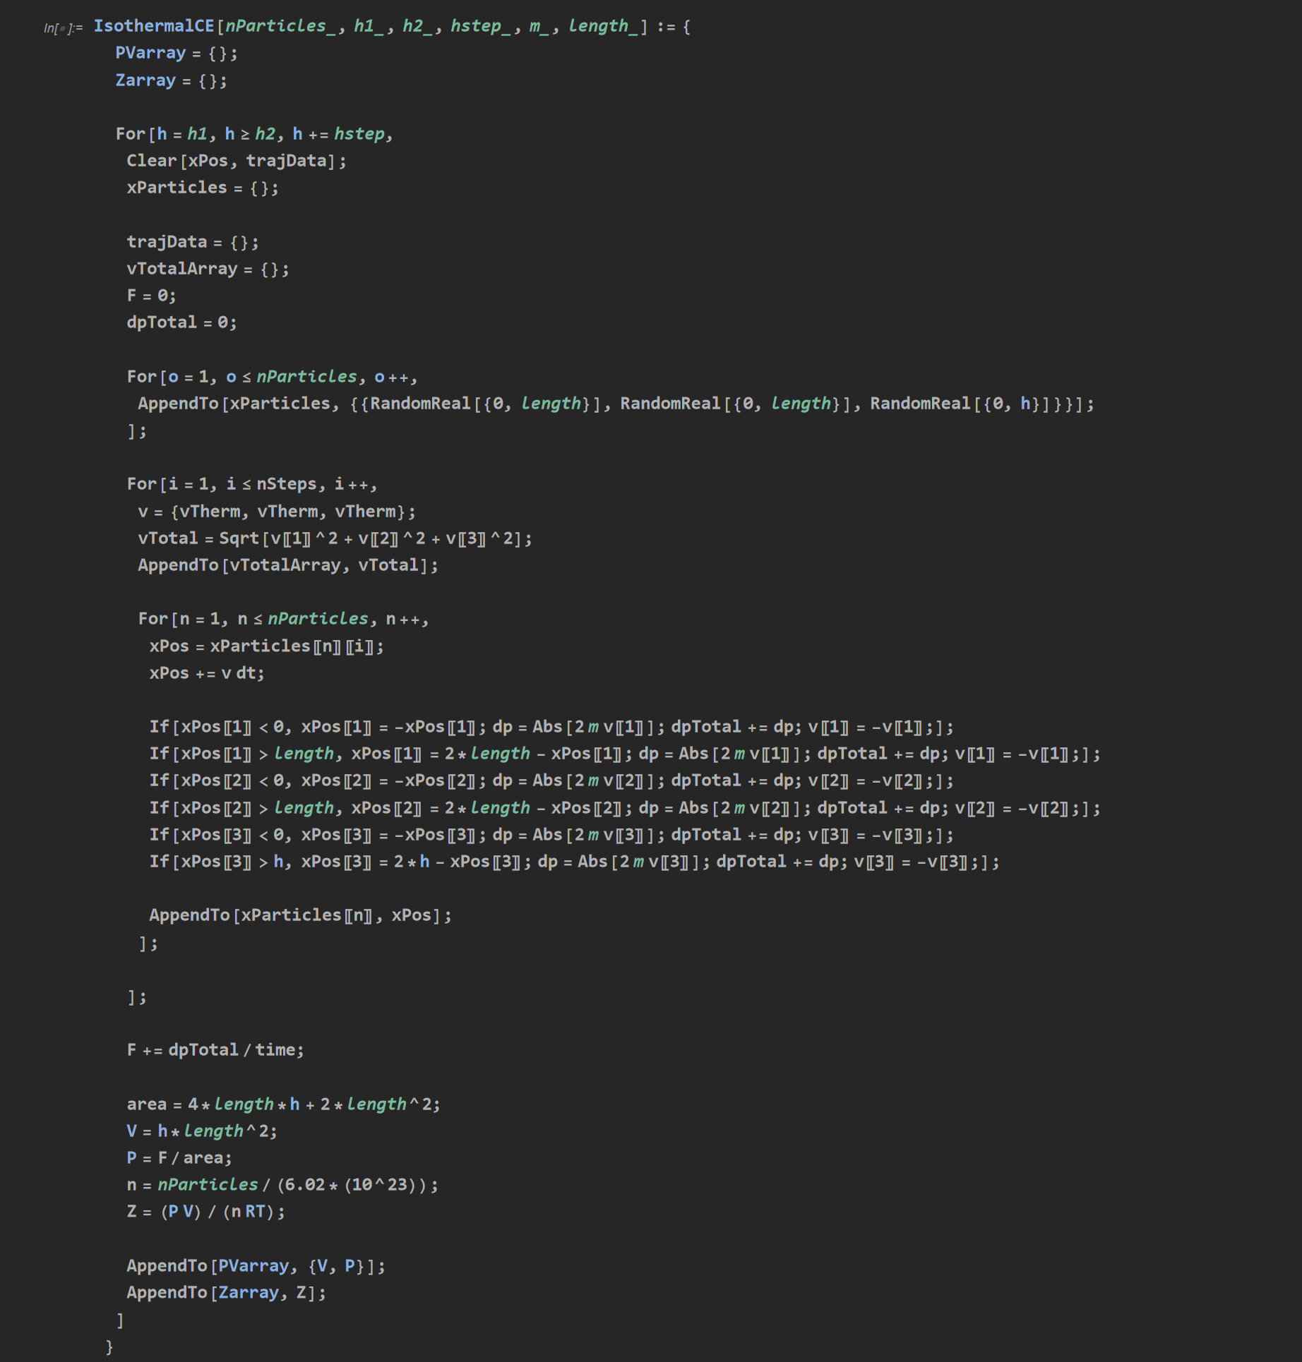
Simulation for Isothermal Compression

Slide 12
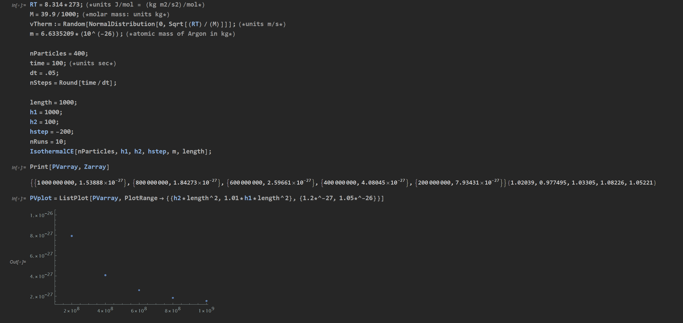
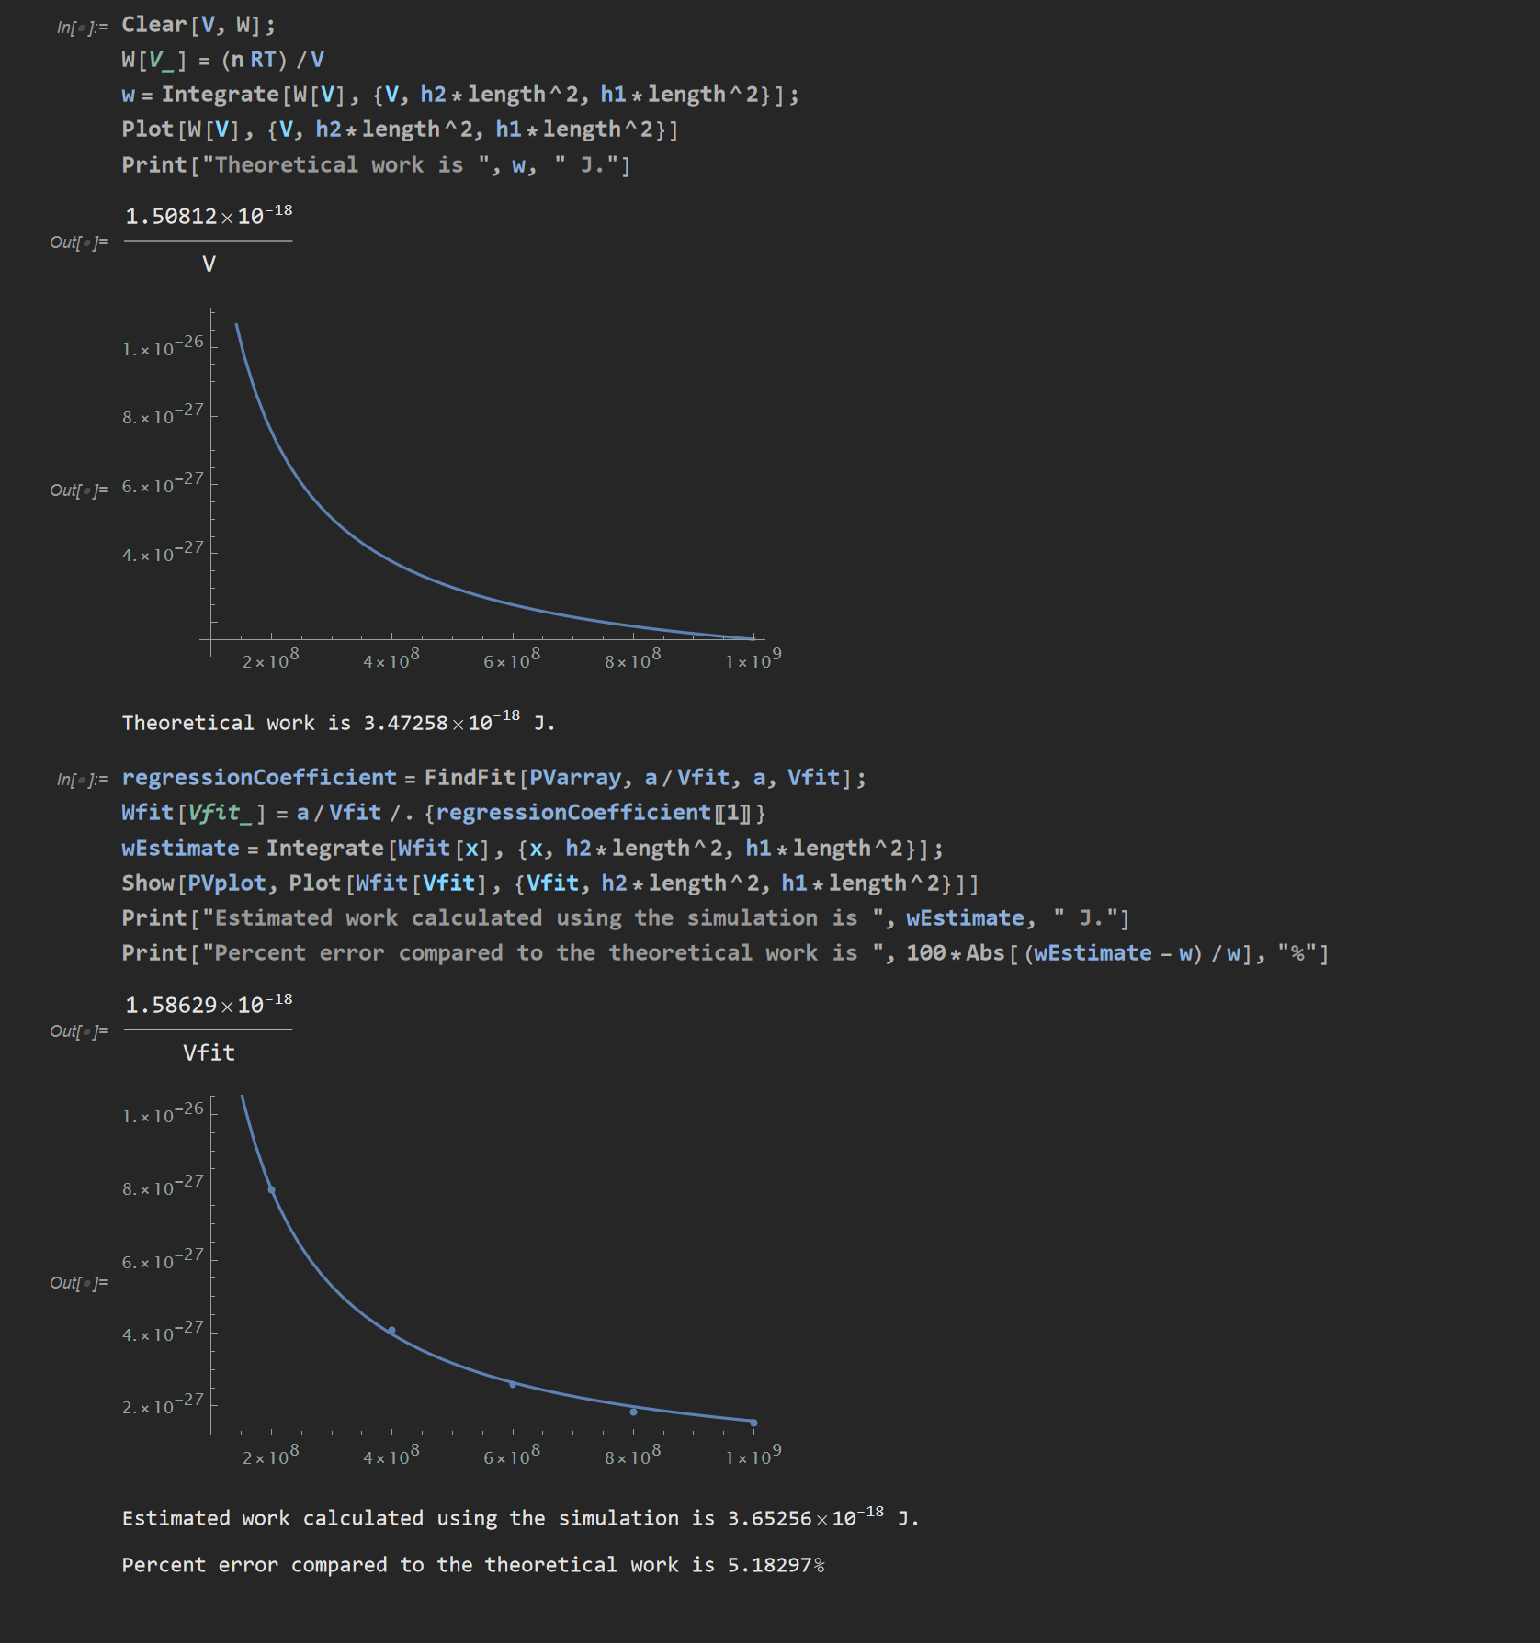
Estimated work using simulation: about 3.653E-18J Error compared to theoretical integral = about 5.183%

Slide 13
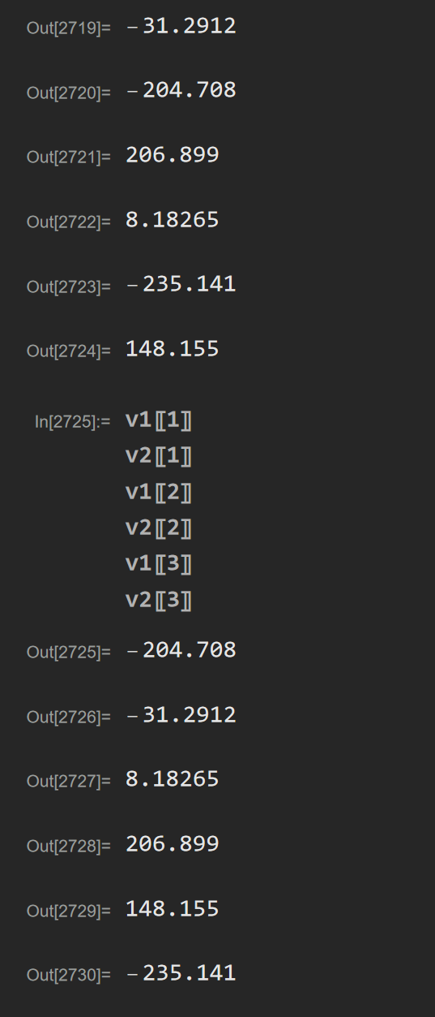
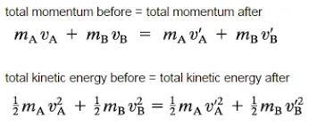
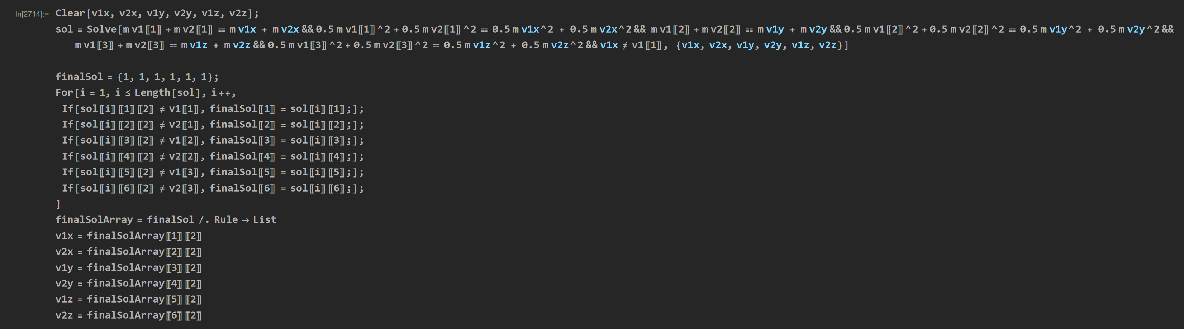
Elastic Collisions of Two Particles

Slide 14

Simulation Including Elastic Collisions of Two Particles at a Time

Slide 15
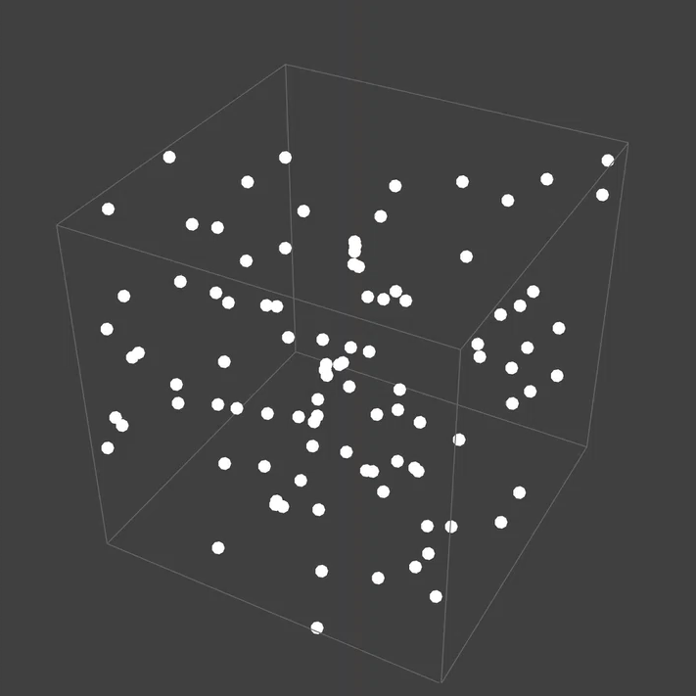
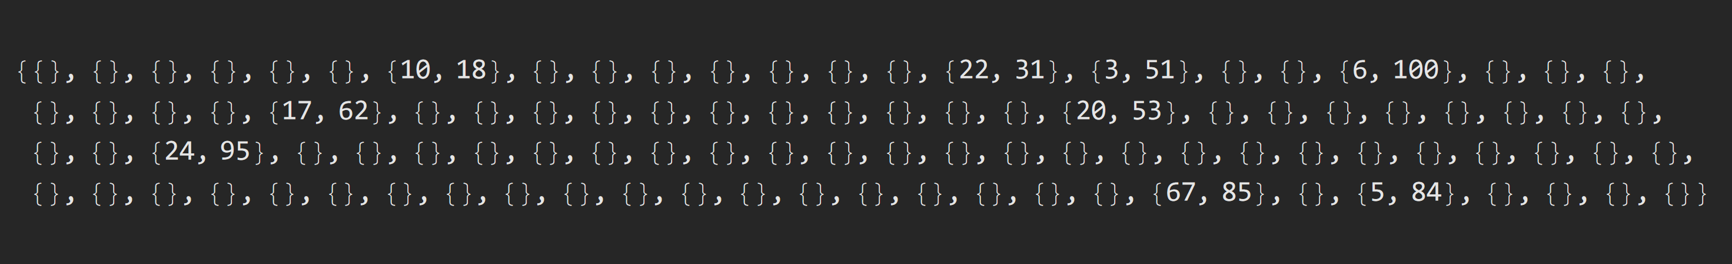
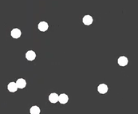
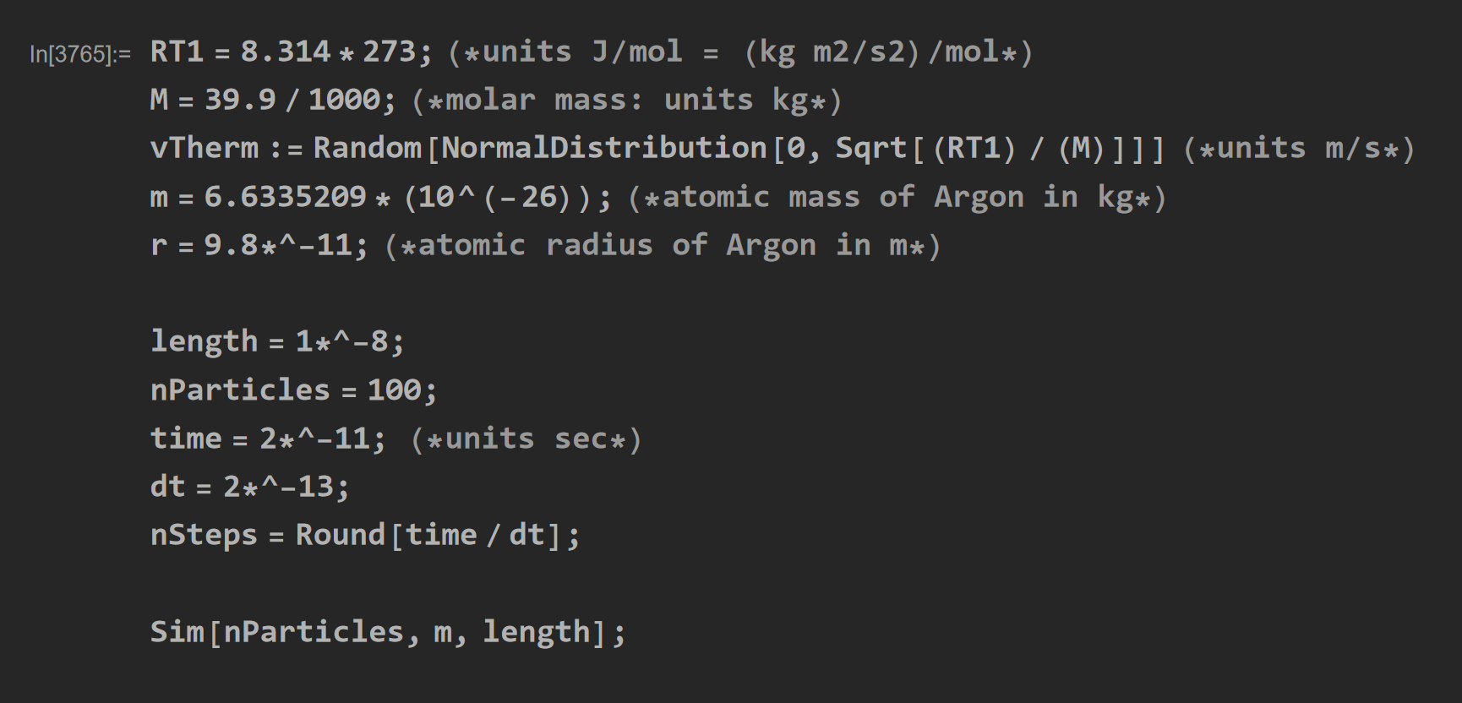
Conditions: T=273K Box Length=1E-8m # of Particles=100 time=2E-11 sec, dt=2E-13 sec

